Slide 1
IS it Moist?
Iot moisture sensor
Vivek Socrates

Slide 2



Purpose
Detect Moisture Levels
Personal and Commercial Use
Used for:
Irrigation Systems
Water Overflow Detection
Monitoring Controlled Environments:
Server Rooms
Laboratories
Museums

Slide 3
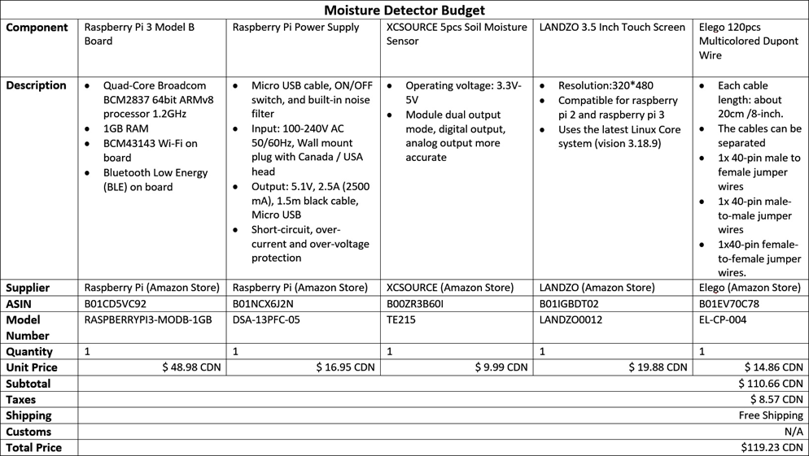
Budget

Slide 4
Time for a Demonstration

Slide 5

Useful prerequisites
Hardware:
Basic electric wiring info
Voltage / Current / Power understanding
Lab practices / precautions
Software:
Basic programming logic
Python scripting
Unix understanding

